Slide 1
Vehicle networks infrastructure
L01 exercise - Tools and Utils basic

Slide 2
Vehicle networks infrastructure
Agenda:
CANoe Basics
CAPL Basics
Restbus simulation Basics

Slide 3
CANoe Basics
Vehicle networks infrastructure

Slide 4
CANoe Basics
What is CANoe?
Advantages
Comprehensive software tool for development, testing, and analysis of individual ECUs and entire ECU networks
Only one tool for all development and testing tasks
Easy automated testing
Extensive possibilities for simulating and testing ECU diagnostics
Detect and correct error situations early in the development process
User-friendly graphic and text-based evaluation of results

Slide 5
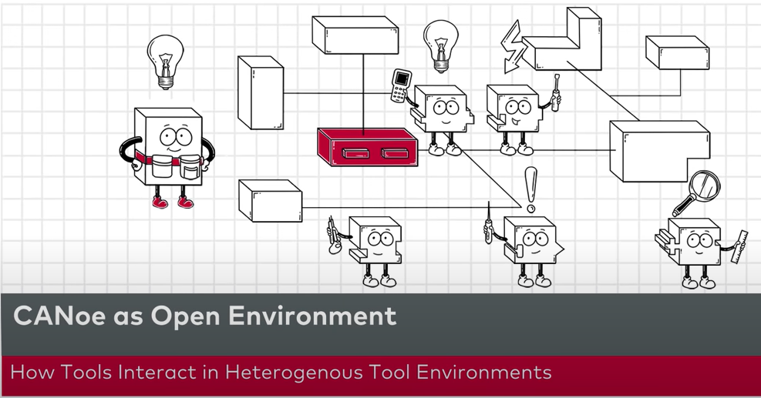
CANoe Basics
Video about CANoe
Let’s learn what is CANoe and how to use it in the video: “Vector's CANoe as Your Problem Solver in Complex Tool Landscapes”
Materials for this exercise can be found on Canvas in the Module section named “M01 - Exercise materials”
From CAN_Autosar folder open CAN_Autosar.cfg

Slide 6
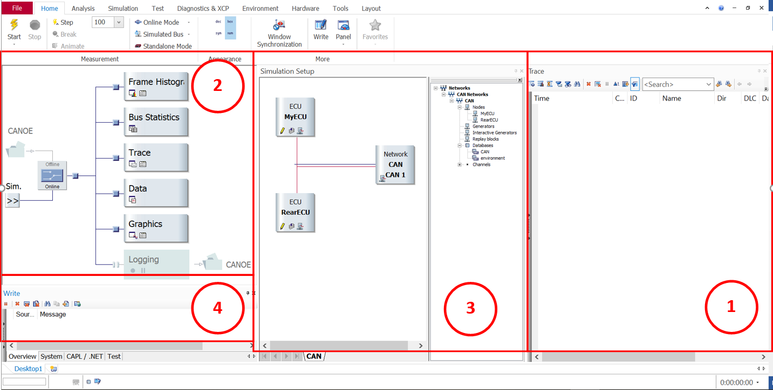
CANoe Basics
Trace Window
Measurement Setup
Simulation Setup
Write Window

Slide 7
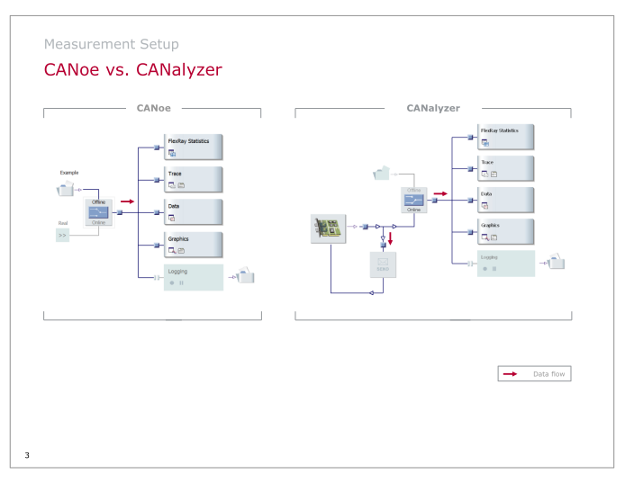
CANoe Basics
CANoe
CANalyser
Notes:
CANoe has the access to the whole simulated bus. CANalyzer only has one node for accessing message frames that are flowing in and flowing out for that node.
CANoe Supports Multi-Node simulations: if you want to simulate an entire distributed system that is multiple nodes connected and interacting in a CAN environment you can do so using CANoe only. Whereas CANalyser supports simulating a single node, so for a distributed system you can only simulate a single node, and the rest of the nodes must be connected physically.

Slide 8
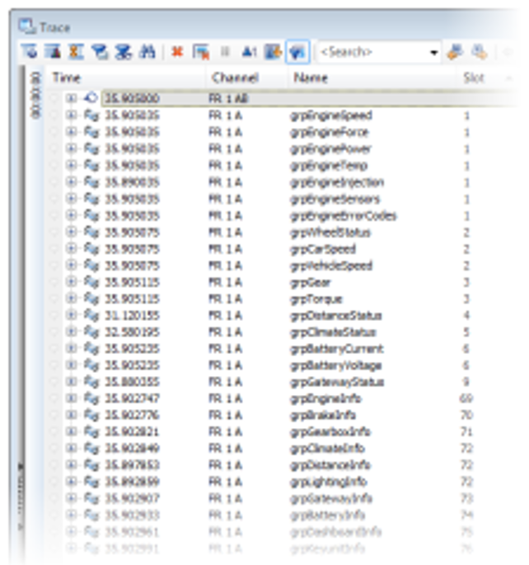
CANoe Basics
Trace window
Analysis window for displaying bus activities and events:
Messages, PDUs, signals
System and environment variables
Messages of the transport protocol
Messages of diagnostics services
POC states

Slide 9
CANoe Basics
Trace window - Live demonstration!

Slide 10
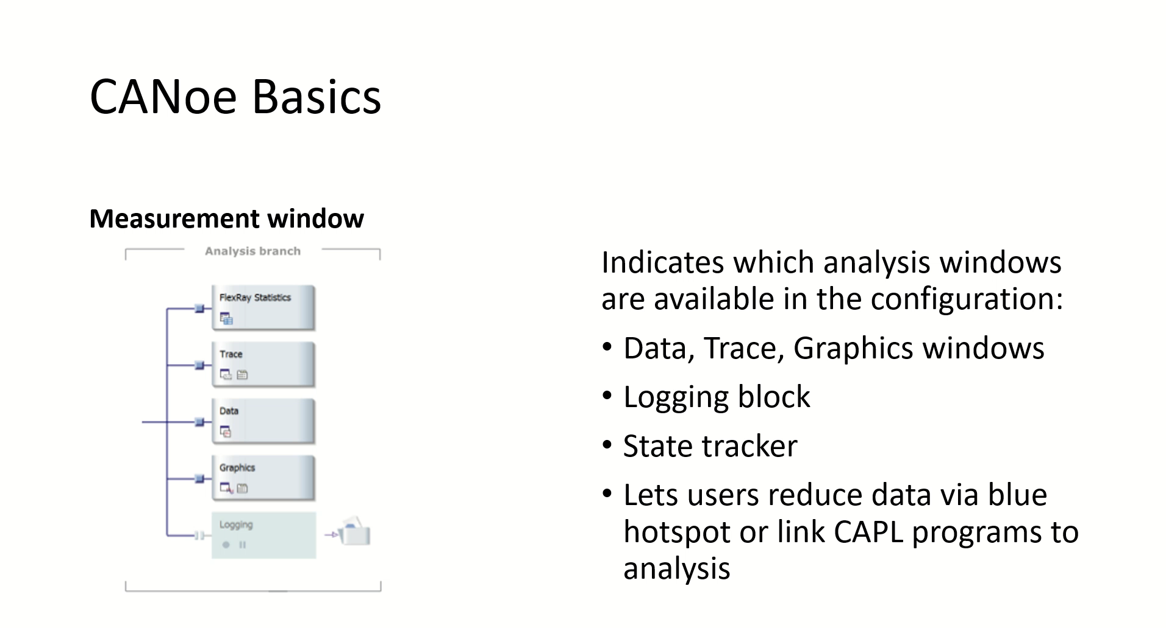
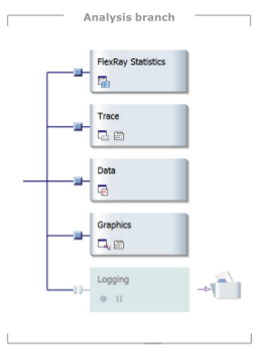
CANoe Basics
Measurement window
Indicates which analysis windows are available in the configuration:
Data, Trace, Graphics windows
Logging block
State tracker
Lets users reduce data via blue hotspot or link CAPL programs to analysis

Slide 11
CANoe Basics
Measurement window - Live demonstration!

Slide 12
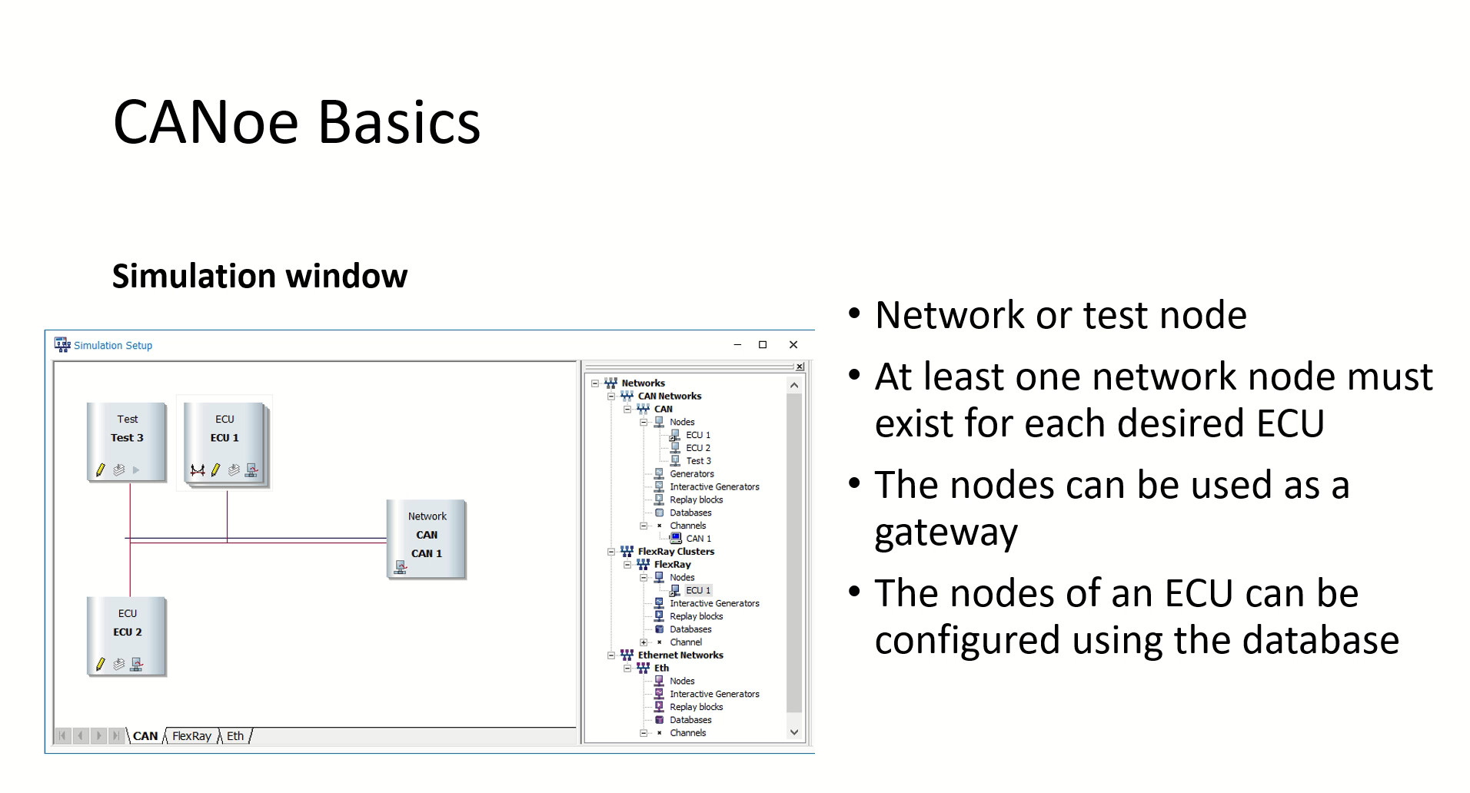
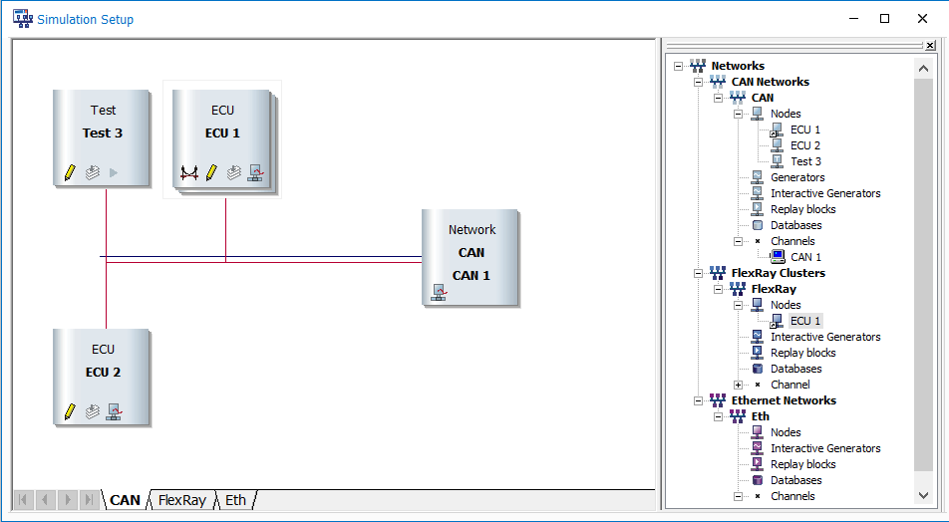
CANoe Basics
Simulation window
Network or test node
At least one network node must exist for each desired ECU
The nodes can be used as a gateway
The nodes of an ECU can be configured using the database

Slide 13
CANoe Basics
Simulation window - Live demonstration!

Slide 14
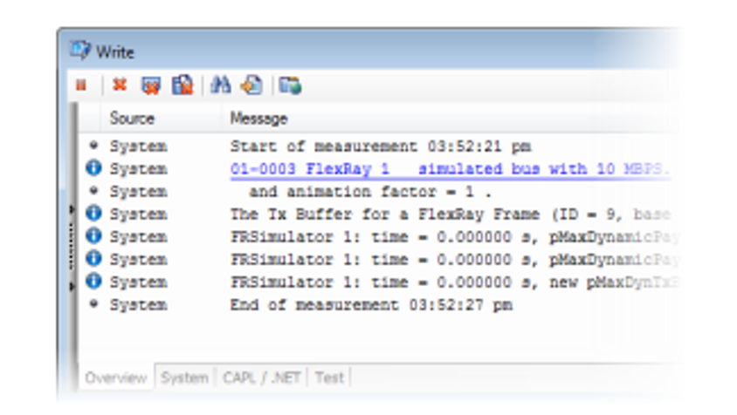
CANoe Basic
Write window
Status and error messages of CANoe
Information on the status of the hardware
Messages from CAPL programs or test modules

Slide 15
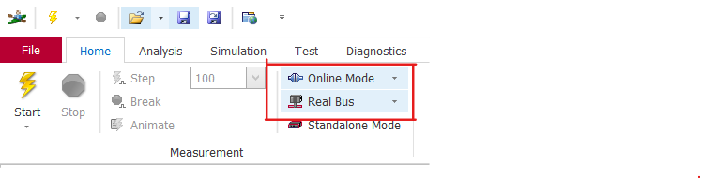
CANoe Basics
Operational modes:
Real bus
Simulated bus
Offline/Online mode

Slide 16
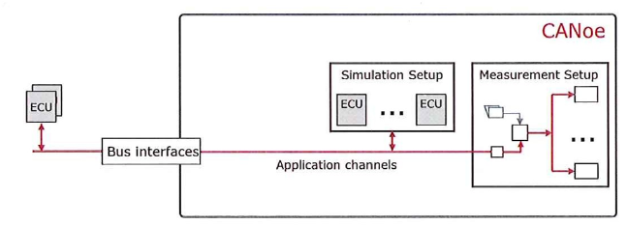
CANoe Basics
Operational mode real bus
Bus interfaces connect CANoe application channels to real bus
Consider driver settings necessarily
Bus communication can be analyzed in the measurement setup
Simulation nodes in the simulation setup act like real ECUs

Slide 17
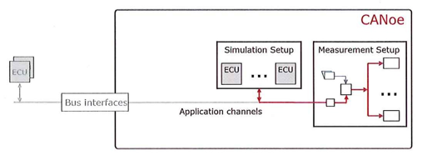
CANoe Basics
Operational mode simulated bus
Bus interfaces are not used
Driver settings are not important
Simulated ECUs exchange messages still

Slide 18
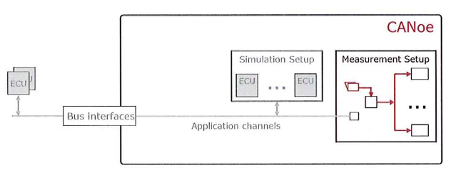
CANoe Basics
Offline mode
Measurement setup processes data from a log file
Driver settings are not important
Simulated ECUs and bus interfaces are inactive

Slide 19
CAPL Basics
Vehicle networks infrastructure

Slide 20
CAPL Basics
Functional blocks based on CAPL (Communication Access Programming Language) can be created to program :
Network node modules
Special evaluation programs for individual applications

Slide 21
CAPL Basics
Some CAPL characteristics:
C-like programming language u Event-based, not interrupt-driven
CAPL programs are created using an integrated development environment called the CAPL Browser
Direct access to signals, system variables, and diagnostic parameters
Able to link user-created DLLs

Slide 22
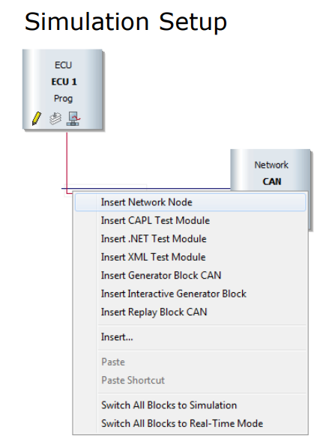
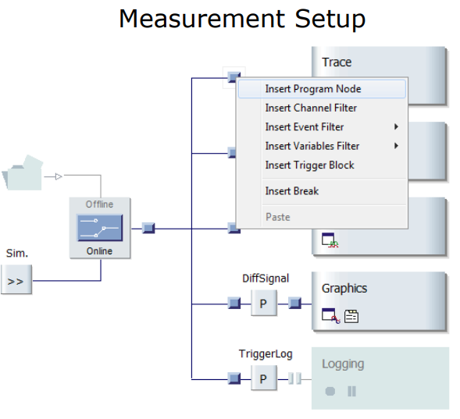
CAPL Basics
Creating and extending simulations
Implementing functions for analysis in the measurement setup

Slide 23
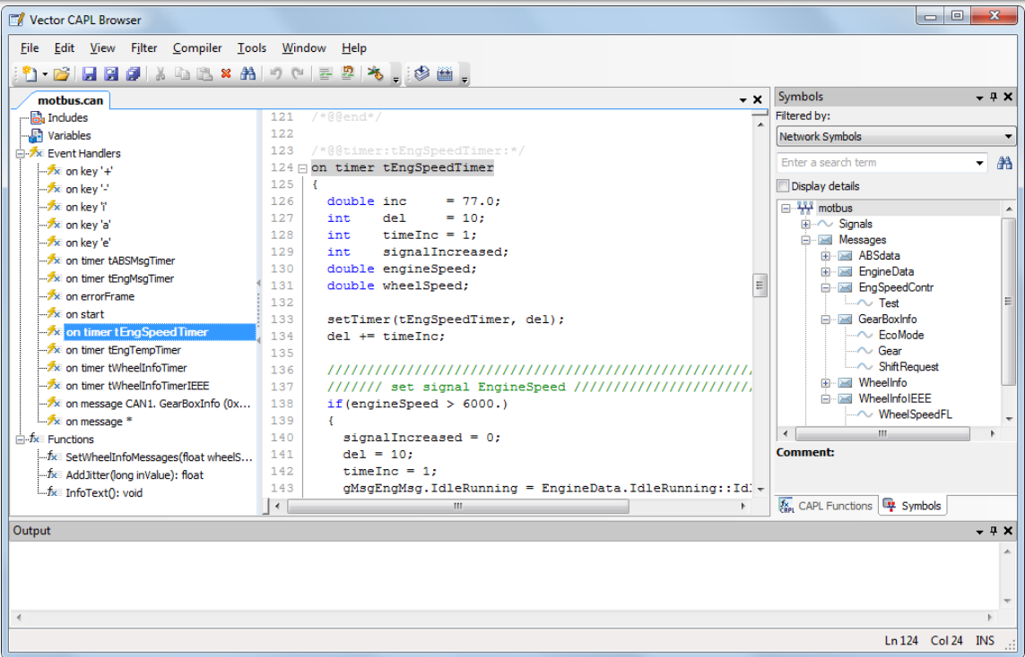
CAPL Basics
CAPL Browser

Slide 24
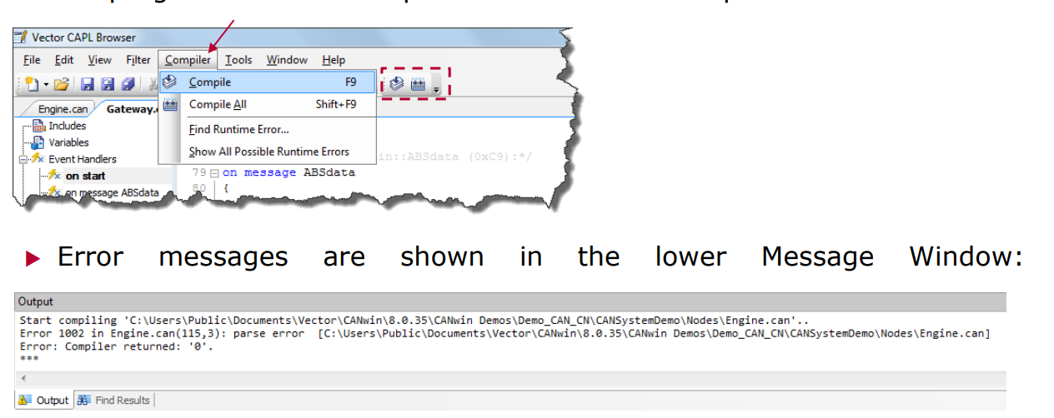
CAPL Basics
Compiling
In order to generate an executable program file from a CAPL program, the program must be compiled with the CAPL compiler

Slide 25
CAPL Basics
Data types for CAN
Type |  | Name | Bit | Note
Integers | Signed Unsigned | int long int64 byte word dword qword | 16 32 64 8 16 32 64
Floating point |  | float double | 64 64 | Per IEEE
Single character |  | char | 8
Message variable | for CAN | message |  | for CAN messages
Time variables | for seconds for milliseconds | timer mstimer |  | for Timer in s for Timer in ms

Slide 26
Restbus simulation Basics
Vehicle networks infrastructure

Slide 27
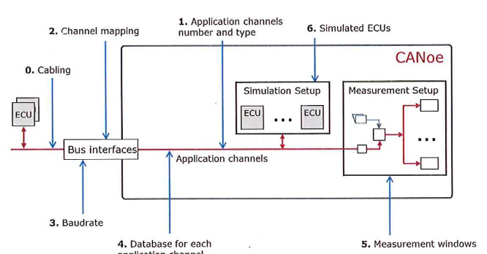
Restbus simulation Basics

Slide 28
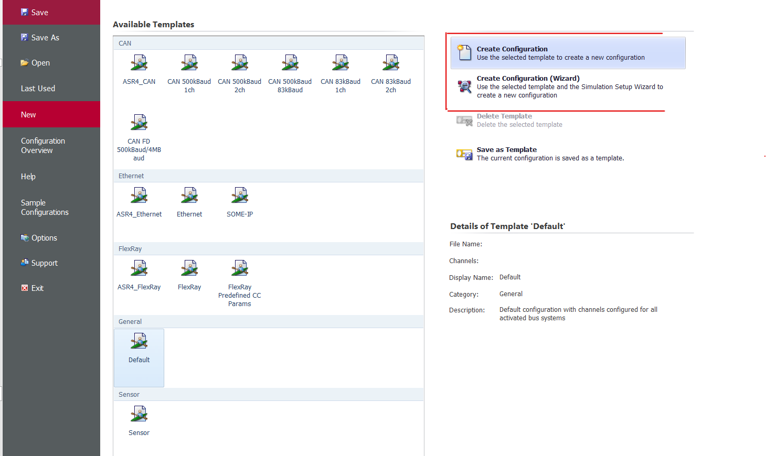
Restbus simulation Basics
How to create CANoe simulation?
Using Wizard
Manually

Slide 29
Restbus simulation Basics
Configuration using wizard
1. Step: Create new configuration with wizard
2. Step: Associate a database
3. Step: Add ECUs
4. Step: Set hardware channel
5. Step: Complete the configuration
6. Step: Define the Coldstart nodes
7. Step: Define Wakeup

Slide 30
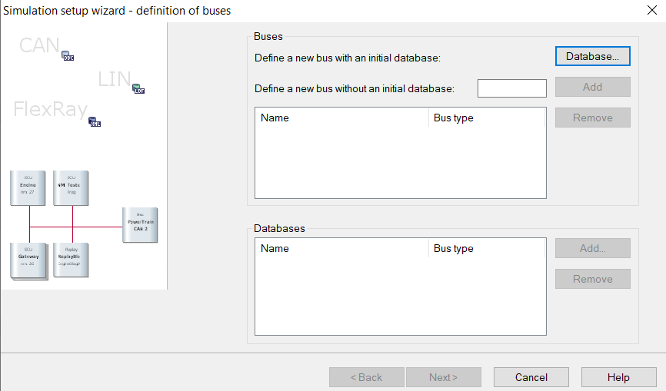
Restbus simulation Basics
Let’s do it live!!!

